Slide 1

Big Graph Analytics using Low-rank Approximations
Dimitris Papailiopoulos
UT Austin
Based on Joint work with:
Alex Dimakis
Ioannis Mitliagkas
Asteris Megasthenis
Constantine Caramanis

Slide 2
Densest k-Subgraph (DkS)
Given a graph and a parameter k,
find the k vertices that contain the largest #edges.
Applications:
Community Mining
communities = large dense components
Link Spam Detection
dense parts of web -> spam
Computational biology
complex patters in gene annotation graphs
Here for k=5 there is a 5-subgraph with 10 edges (5 clique).
Q: Can you find it?

Slide 3
Densest k-Subgraph (DkS)
Given a graph and a parameter k,
find the k vertices that contain the largest #edges.
NP-hard
Hard to approximate
Here for k=5 there is a 5-subgraph with 10 edges (5 clique).
Q: Can you find it?

Slide 4
Worst-Case Analysis
After long study the best ratio [Bhaskara et al., STOC ’10]
10-factor approx for graphs with 10K nodes
100-factor approx for graphs with 100 Million nodes.

Slide 5
Known DkS guarantees are not useful in practice…
under worst case analysis
Q1: Provable, graph-dependent bounds?
Q2: DkS on billion-scale graphs?

Slide 6
Moving Beyond the Worst-Case
A new DkS algorithm with graph-dependent bounds:
Give me a graph, I run the algorithm, I tell you how far OPT is
In most tested graphs provably
Scalable to billion-edge graphs
nearly-linear times for many real-world graphs
Parallelizable: implementation in MapReduce+Python
experiments up to billion-edge graphs on 800 cores on Amazon EC2

Slide 7
Graph Dependent Guarantees
Thm 1:
Spannogram computes in time a k-subgraph with density
Thm 2: If the largest d eigenvalues of the adjacency are positive:
The Spannogram computes in time a k-subgraph with density

Slide 8
Trivial upper bound = k-1

Slide 9
Trivial upper bound = k-1
Blue: Tpower JMLR’13 Green: GreedyFeige Algorithmica ’01 Yellow: GreedyRavi OR ’94

Slide 10
Trivial upper bound = k-1
Big Gap
Blue: Tpower JMLR’13 Green: GreedyFeige Algorithmica ’01 Yellow: GreedyRavi OR ’94

Slide 11
Trivial upper bound = k-1
d=1 spannogram
Blue: Tpower JMLR’13 Green: GreedyFeige Algorithmica ’01 Yellow: GreedyRavi OR ’94

Slide 12
Trivial upper bound = k-1
d=2 spannogram
Blue: Tpower JMLR’13 Green: GreedyFeige Algorithmica ’01 Yellow: GreedyRavi OR ’94

Slide 13
Trivial upper bound = k-1
d=5 spannogram
Blue: Tpower JMLR’13 Green: GreedyFeige Algorithmica ’01 Yellow: GreedyRavi OR ’94

Slide 14
Trivial upper bound = k-1
Smaller Gap
Blue: Tpower JMLR’13 Green: GreedyFeige Algorithmica ’01 Yellow: GreedyRavi OR ’94

Slide 15
Graph-dependent bound
80% OPT
Blue: Tpower JMLR’13 Green: GreedyFeige Algorithmica ’01 Yellow: GreedyRavi OR ’94

Slide 16
DkS via Quadratic Optimization
vertex
Edges
In subgraph
vertex
DkS:

Slide 17
DkS via Bilinear Optimization
Why?
my tools work for bilinear
but…
Lem: ρ-approximation for DBkS = ½ρ-approximation for DkS
DBkS:
DkS:

Slide 18
A new low-rank framework
When the matrix is not low-rank:
Compute : a rank-d approximation via SVD
solve exactly on
obtain guarantees.
* When the d largest eigenvalues of the adjacency are positive
Spannogram DBkS:
We can solve it in time *
*Under mild conditions, we essentially solve it in

Slide 19
How the low-rank solver works
- Naively, we can solve DkS by testing all k-subgraphs.
- But… what if the matrix is low-rank?
Rank-1 case:
Q: Maximize the product of two numbers?
A: Maximize each number individually: find the k largest elements of v

Slide 20
How the rank-1 solver works
Def: top-k set: the k-largest cordinates of a vector,
e.g., if k =2, then top-2 set = {3,4}
Intuition: x, y pick the top-k set of v.
1 2 3
4
1 2 3
4

Slide 21
How the rank-2 solver works
Intuition: x, y pick the top-k set of a vector from a 2-dimensional span.
[Asteris, P., Karystinos (TUC), 2011]
1
2
3
4
5
2
7
0
1
2
3
4
5
2
7
0
Q: How many top-k sets are there in a 2-dimensional span?
Theorem: # top-k sets in a d-dimensional span:

Slide 22
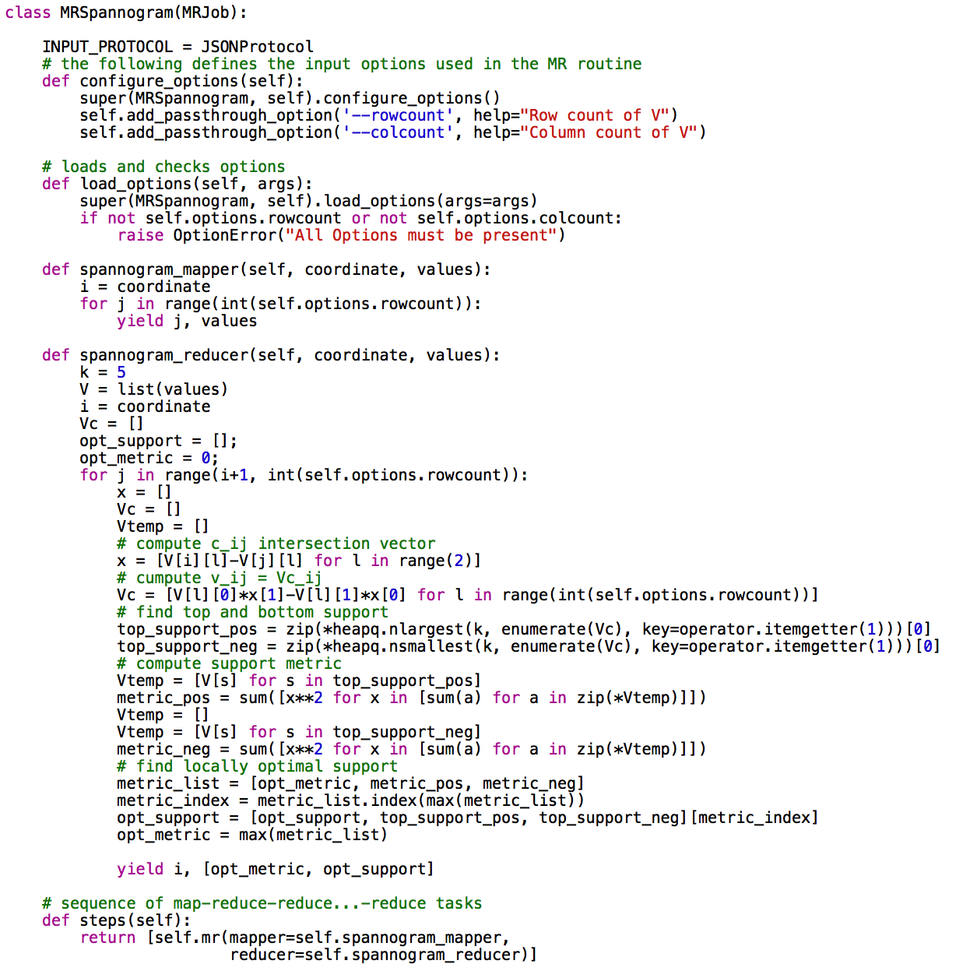
Mapreduce Implementation

Slide 23
Billion-scale Graphs

Slide 24
Conclusions
A new combinatorial approximation algorithm for DkS.
Graph-dependent spectral bounds: OPT within 70% in most experiments.
Our bound could be trivial in the worst case.
Empirically outperforms previous state of the art
Current work:
Study bounds under common QP framework:
Sparse PCA, NMF, MaxCut,…
Connect to combinatorial geometry (extreme points of zonotopes etc)?

Slide 26
the end

Slide 27
Experiments

